Slide 1
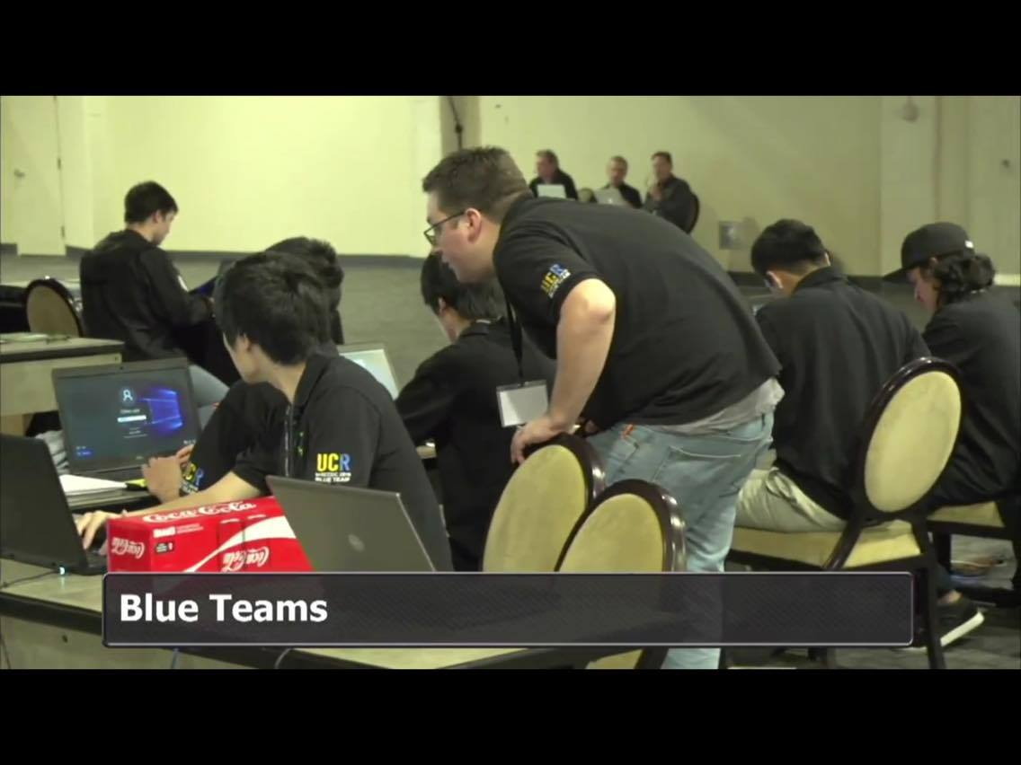
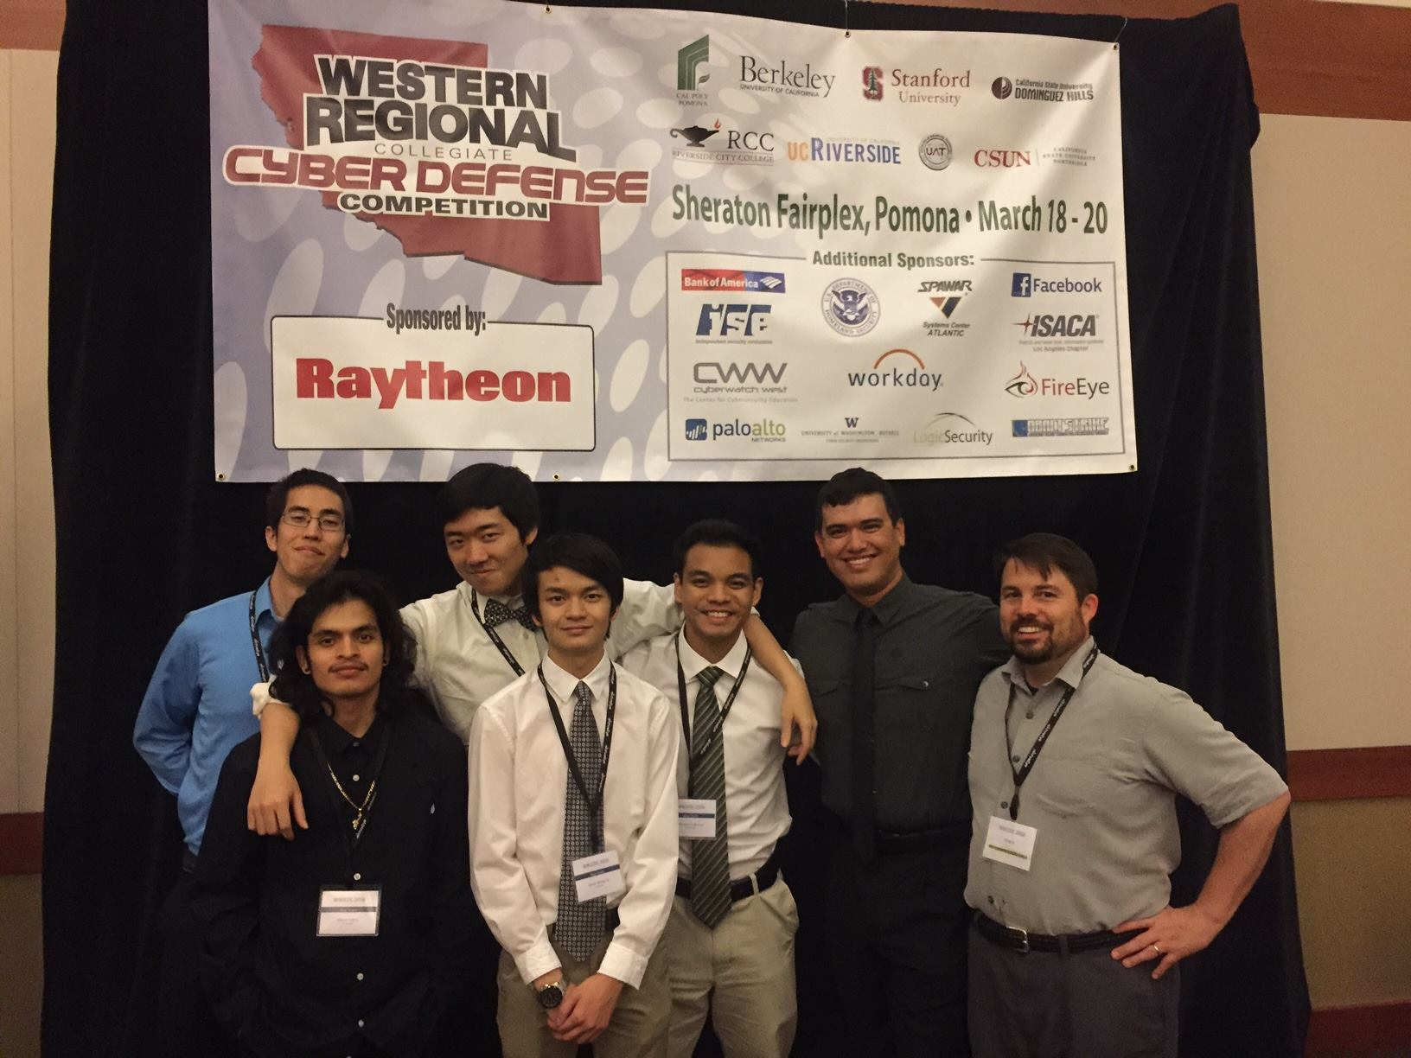
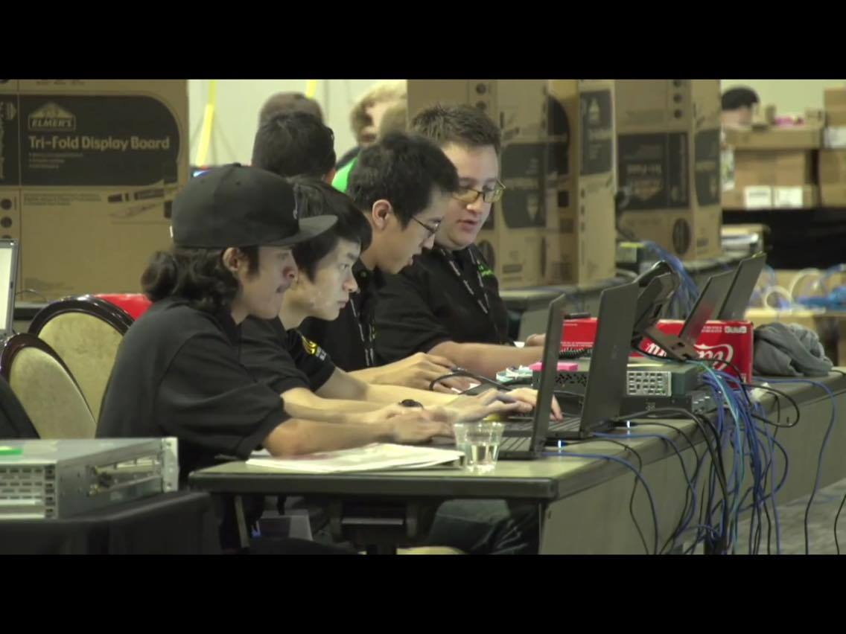
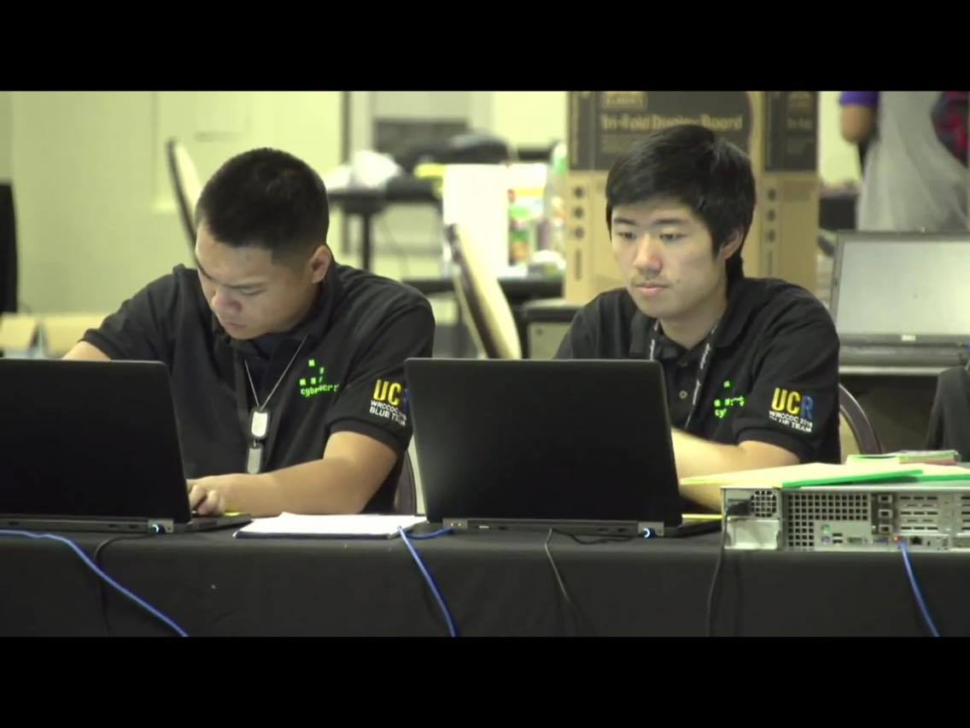
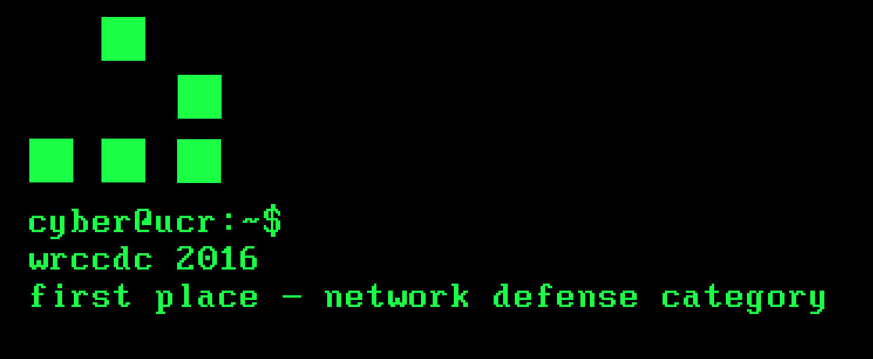

Slide 2

Our first competition
WRCCDC 2016 Regionals
1. Cal Poly Pomona
2. University of Advancing Technology
3. UC Berkeley
4. Stanford University
5. University of California, Riverside
6. California State University, Dominguez Hills
7. California State University, Northridge
8. Riverside City College

Slide 3
WRCCDC Competition Format
Competitors are the “Blue Team”
Clients are the “Orange Team”
“Previous Blue Team” are the “Black Team”
Attackers are the “Red Team”
Judges/Referees are the “White Team”

Slide 4
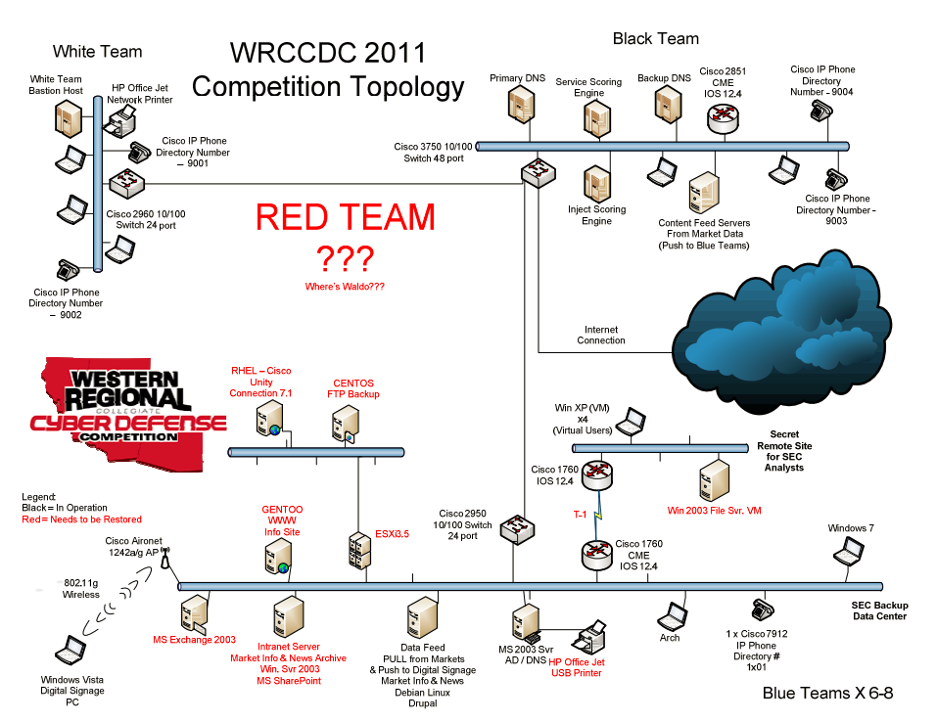
WRCCDC

Slide 5

Examples of what happens when you let red team in

Slide 6
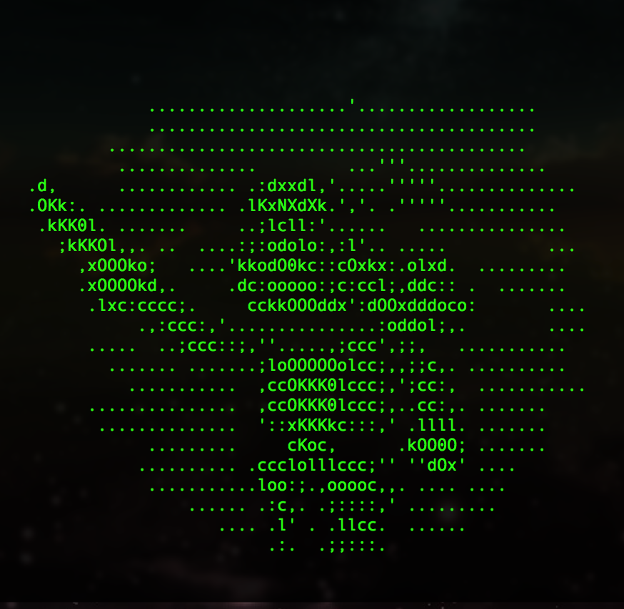
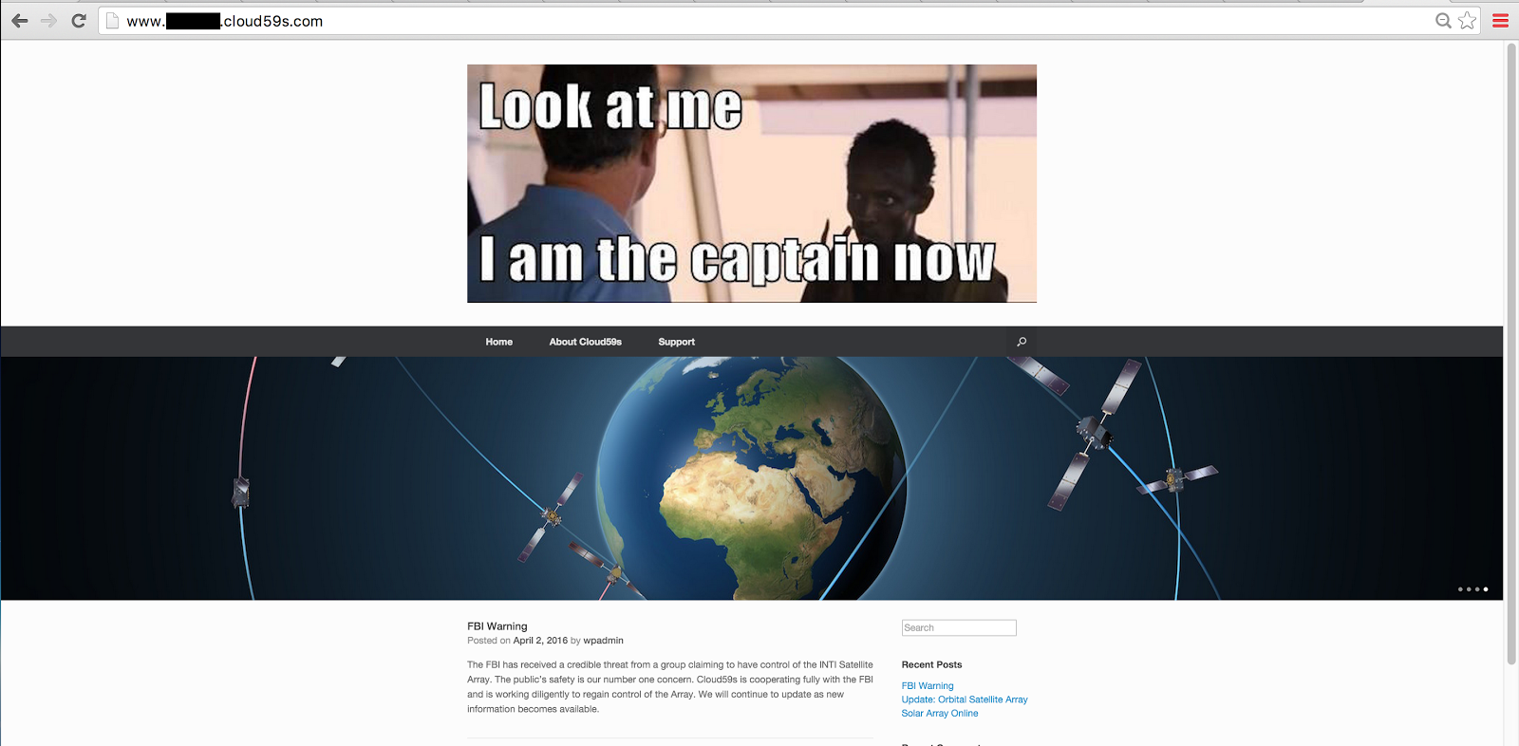
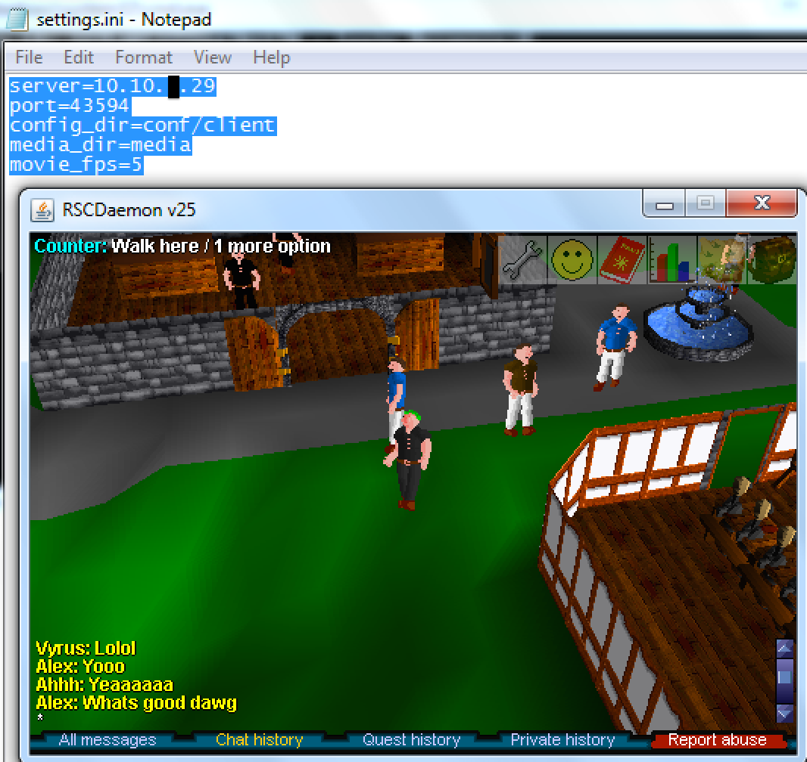
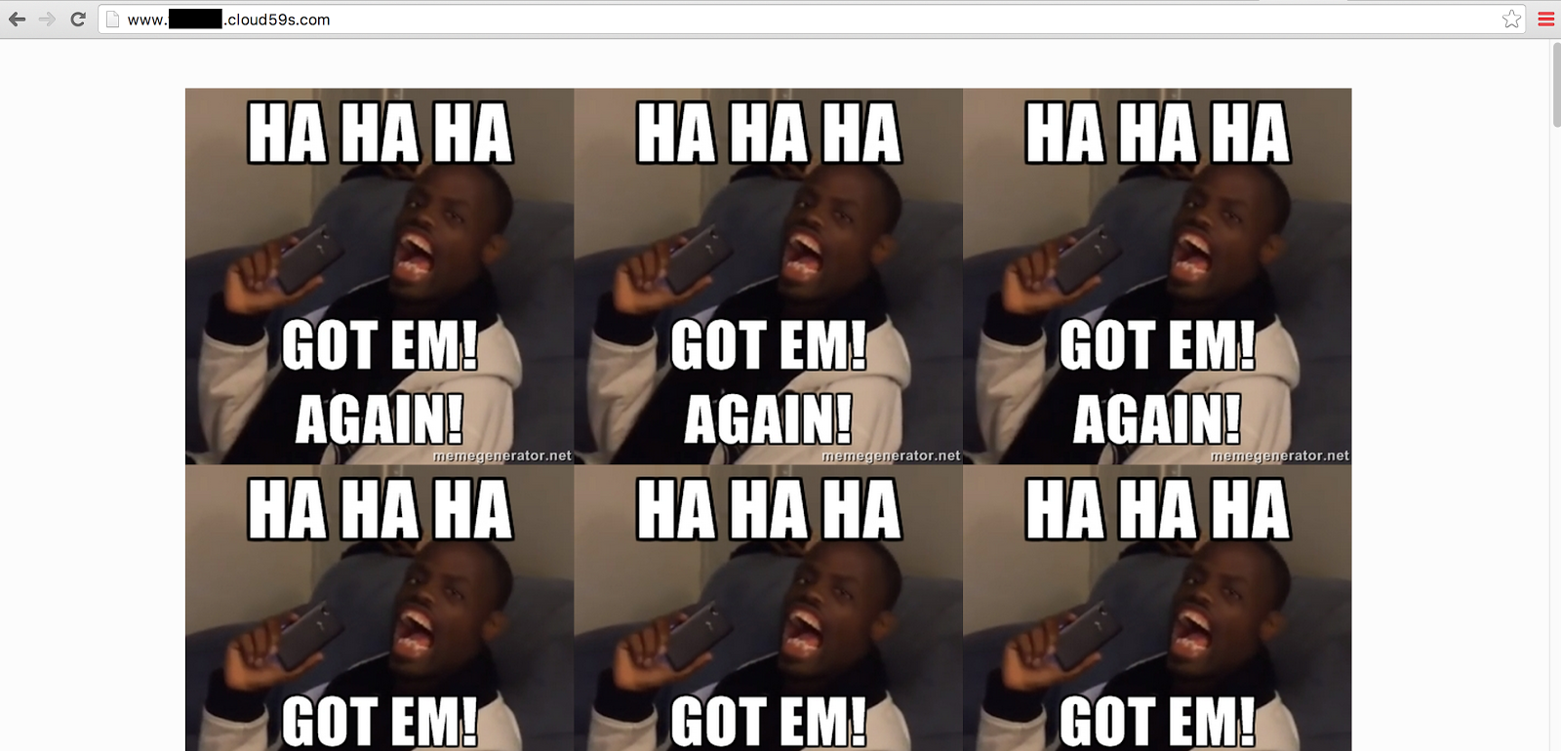
Examples of what happens when you let red team in

Slide 7
Cyber@UCR Goals
Organize teams to represent UCR at cybersecurity competitions
Advocate for the use of secure design principles in engineering
Raise awareness of topics related to information security
Promote the professional development of students interested in security related careers
Form faculty and community partnerships for the advancement of information security awareness
Advance the ethical study of cybersecurity

Slide 8
Why get into CyberSec?
Gain new security perspective on future projects you may be involved in
IoT
Database management
Web development
Programs in general
Gain useful experience by going into unknown environments and learning about what is suspicious, what is necessary, and what is going to explode.
Be involved in an exciting field of study with new exploits, vulnerabilities, and defense methods being discovered all the time.

Slide 9

Intimidated or feel like you don’t know enough?
Don’t worry, most of us were too.

Slide 10
What’s next?

Slide 11

Cyber-security related competition
Can be imagined as “Capture the Flag”
Composed of various individual challenges to obtain “flags”
Computer Forensics
Cryptography
Network penetration testing
Web security
System/Network Administration
Etc.
Entirely online in virtual “stadium”
Registration ends April 26th
Runs May 2nd - June 30th
NCL Spring

Slide 12
Doesn’t start until likely Winter 2016
PLENTY of time to train, learn and get prepared
Being on the team not entirely guaranteed, will be very dependent on effort in training
Great opportunity to compete in a realistic working scenario
WRCCDC 2017

Slide 13
Any questions?
Be sure to check us out at https://www.facebook.com/groups/ucrcyber/
If you have any questions or concerns, feel free to email Bradley Evans (President) at bevan006@ucr.edu
To check out some of our reports from WRCCDC 2015, go to https://goo.gl/aQTOhi
Notes:
You should add more people

